Slide 1
DEEP LEarNiNg MastEr Class
Day-15

Slide 2
Announcement
Attendance Link will be Available around 7:30 PM

Slide 3
01
CNN Architecture
Concept

Slide 4
Convolutional neural network
FC_4
Fully Connected
Neural Network
FC_3
Fully Connected
ReLU Activation
Max-pooling
(2x2)
0
Conv_2
Convolution
(5x5)
1
Conv_1
Convolution
(5x5)
Max-pooling
(2x2)
2
.
.
.
.
9
Output
Input
28x28x1
n1 channels
(24 x 24 x n1)
n1 channels
(12 x 12 x n1)
n2 channels
(8 x 8 x n2)
Flattened
n2 channels
(4 x 4 x n2)
n3 units

Slide 5
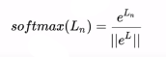
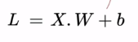
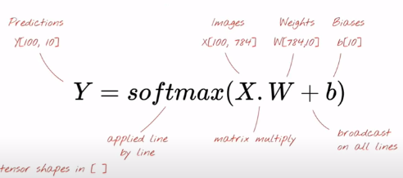
Simple Softmax Classification

Slide 6
Simple Softmax Classification
784 Pixels
….
.
.
.
.
Input
28x28x1
.
.
.
.
0
1
2
3
9

Slide 7
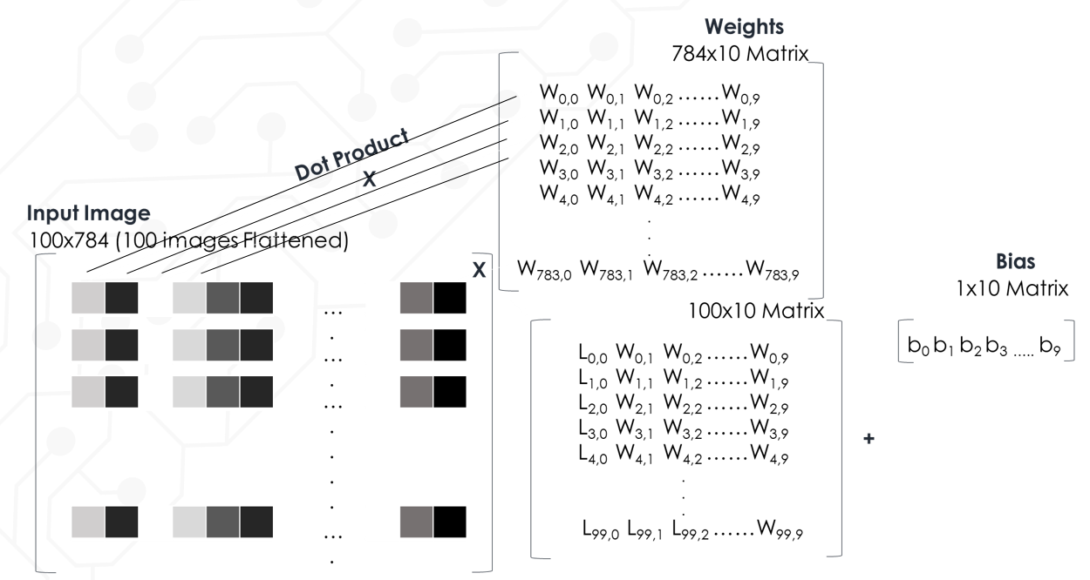
100 image at a time.

Slide 8
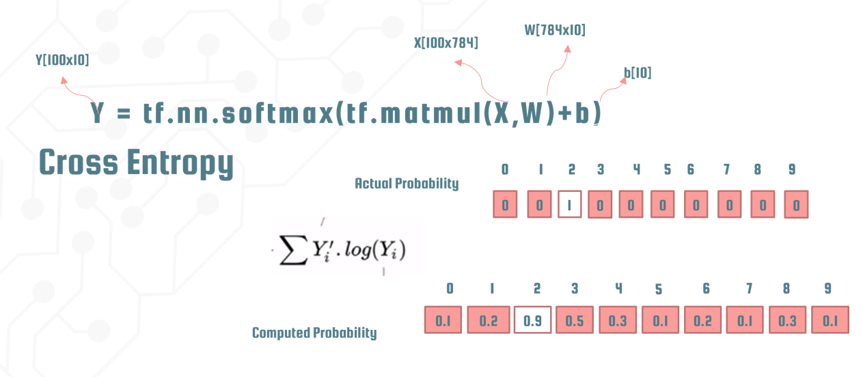
In TensorFlow.

Slide 9
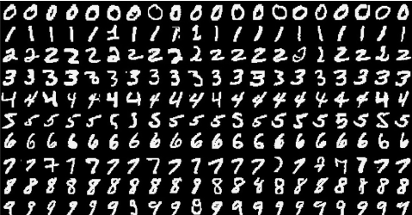
CNN for Mnist Digit Classification

Slide 10

Deep Learning Terminology - 1
Data Augmentation
It refers to the addition of new data that come from the given data, which might prove to be beneficial for prediction.
For example:
Let us assume we have a digit “ 9 “. We can also change its recognition. But if it’s rotating or tilting. Thus, rotation help to increase the accuracy of our model. Although, we increase the quality of data by rotating. Hence, called for Data Augmentation.

Slide 11
Deep Learning Terminology - 2
Bounding Box
Bounding Box is used in object detection in which the objects are wrapped around an imaginary rectangle.
It shows the spatial location of an object and is presented by a set of coordinates that tends to bound the object by the smallest enclosing box.

Slide 12
Deep Learning Terminology - 3
COCO
It shows the spatial location of an object and is presented by a set of coordinates that tends to bound the object by the smallest enclosing box.

Slide 13



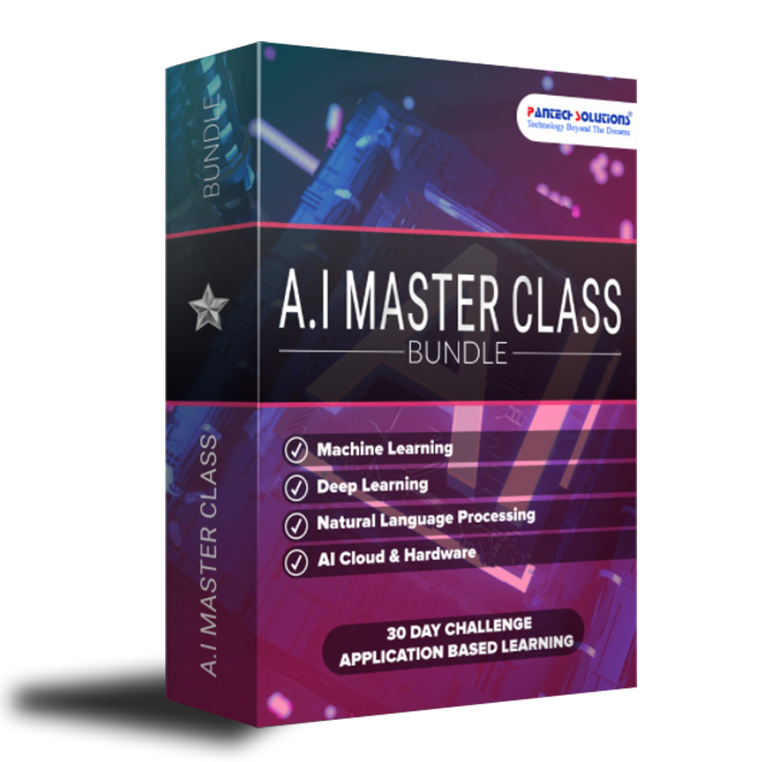

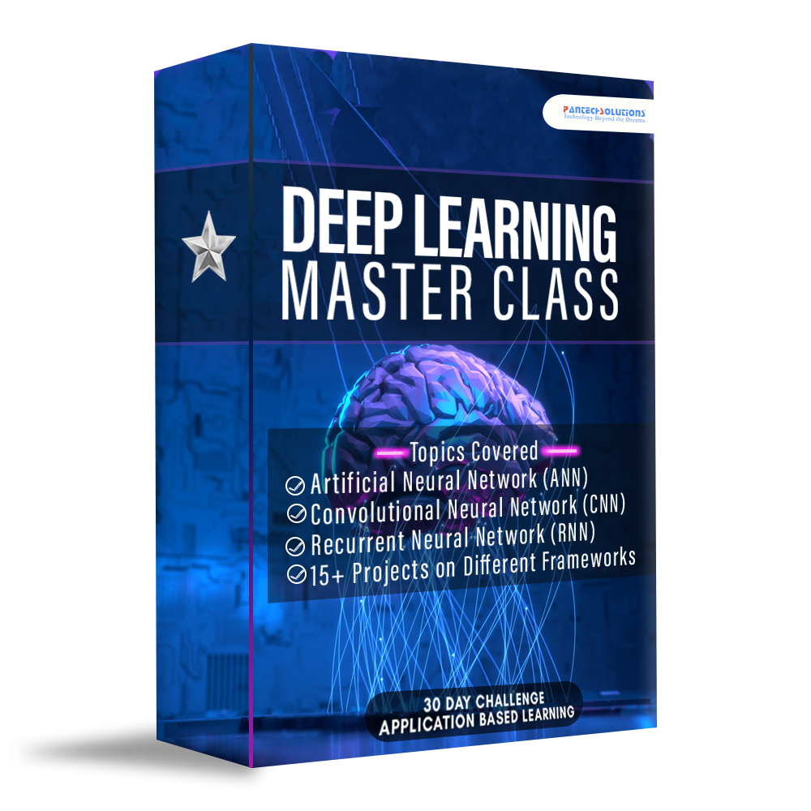



Data Science

Slide 14
Tesla Quotes
Short bytes – D15
“If you want to find the secrets of the universe, think in terms of energy, frequency and vibration.”
“Be alone, that is the secret of invention; be alone, that is when ideas are born.”
I have not Failed, I’ve just found 10,000 ways that won’t work

Slide 15
Q & A Session

Slide 16
Thanks!
Thanks!
Follow Me on LinkedIn : Link in Description
+91 7305845758
Pantechsolutions.net
Ask Your Friends to Participate on this Event

